Slide 1
Measuring perceptions of sexual risk among adolescent girls and young women taking PrEP: A new qualitative method using visual timelines in HPTN 082
Scorgie F, Khoza N, Delany-Moretlwe S, Mangxilana N, Atujuna M, Musara P, Makhale L, Matambanadzo K, Velloza J, Celum C for the HPTN 082 Study Group
@HIVptn
ABSTRACT No: A-1077-0293-02853
Share your thoughts on this presentation with #IAS2019

Slide 2
Background
Use of PrEP for HIV prevention is linked to ‘seasons of risk’ (Mugo et al., 2016; Namey et al., 2016)
AGYW may underestimate their HIV risk – impact PrEP uptake and adherence
Traditional interview methods to understand HIV risk perception are limited by social desirability bias & focus on current partnerships
We adapted a novel approach to elicit perceptions of risk in the context of sexual histories

Slide 3
Method
A ‘participant-empowered’, ‘action-orientated’ approach, inspired by Goldenberg et al., 2016
Visual data serves as an anchor for complex and detailed narratives
Promotes more dialogue
Enhances depth and nuance in the data

Slide 4
Visual relationship timelines
‘Relationship timelines’ were collected from 31 AGYW (16-25 yrs) participating in serial IDIs in a qualitative sub-study of HPTN 082
Timelines captured all relationships from sexual debut to current partner
While participants drew timelines, an interviewer probed about key risk factors in each relationship, incl.:
  condom use
  intimate partner violence
  substance use
  concurrent partners
To assess perceptions of HIV risk, participants assigned a numerical risk score from 1 (least risk) to 5 (highest risk) to each relationship.

Slide 5
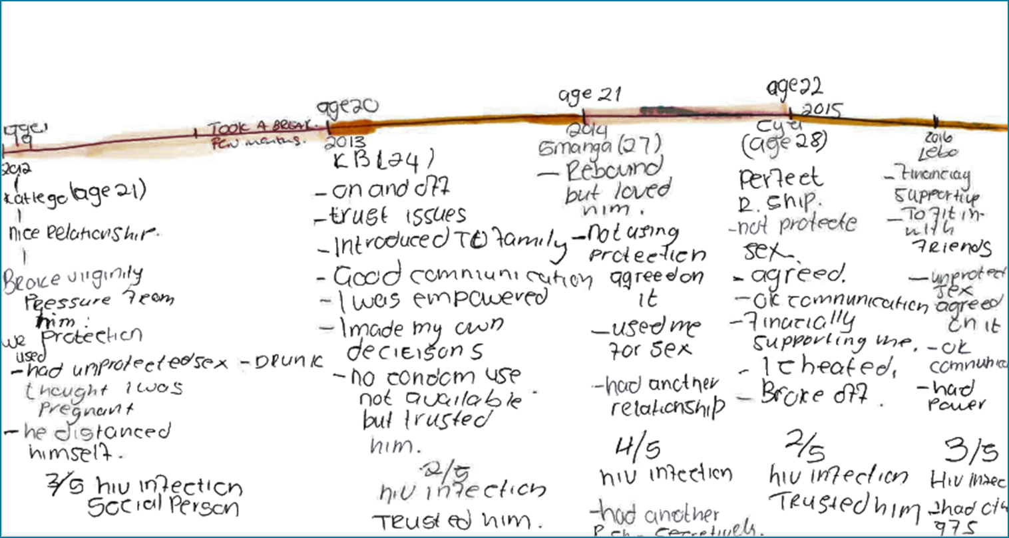
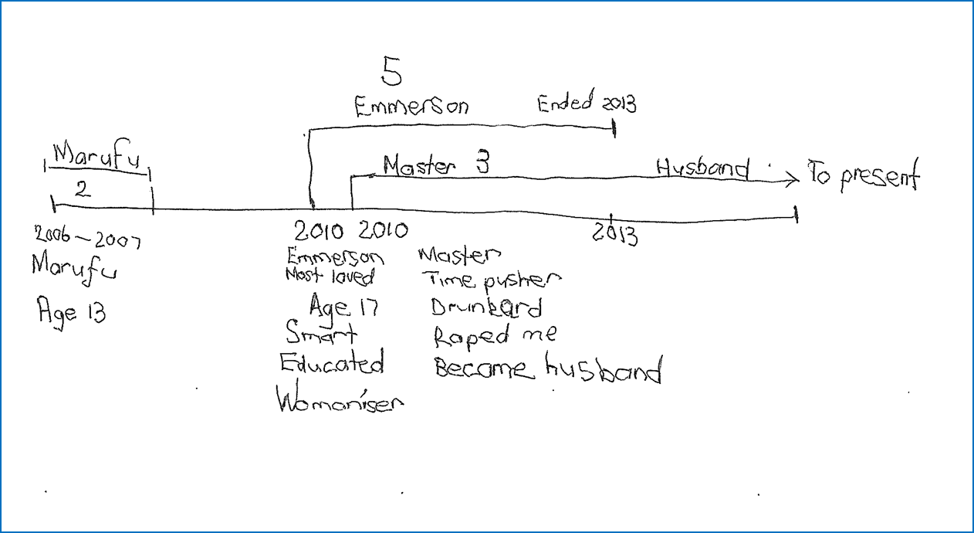
Examples of relationship timelines drawn by HPTN082 study participants in Johannesburg (above) and Harare (right)

Slide 6
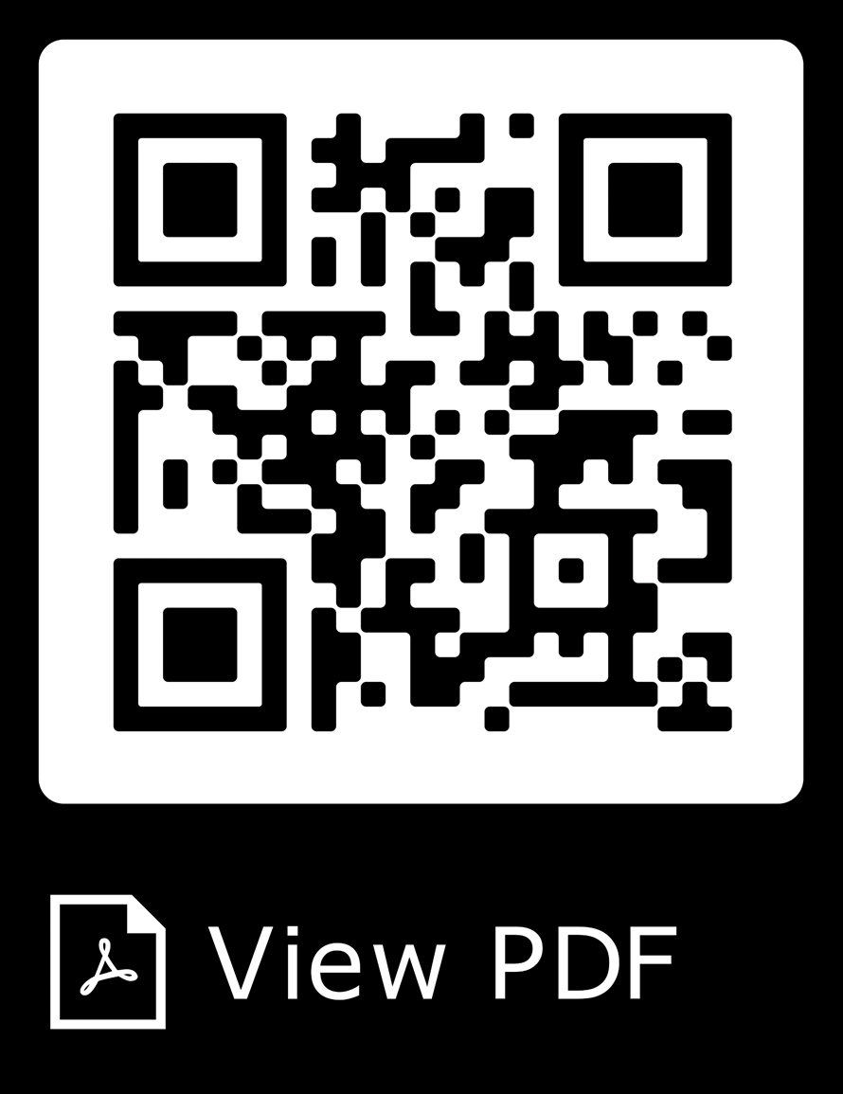
Key findings
Creating the timelines gave AGYW new and valuable insights into lifetime exposure to risk
Their calibration of HIV risk differed from that used in HIV prevention messaging:
  Known or suspected partner infidelity other risk factors (e.g. low condom use, transactional sex) downplayed
  Affirming, egalitarian relationships
  Participants “in love” with partner
PrEP initiation counselling needs to build young women’s skills to
accurately assess HIV risk
The relationship timeline method may help AGYW visualise their risk
exposure over time and align PrEP use with periods of high risk.
HIV risk underestimated

Slide 7
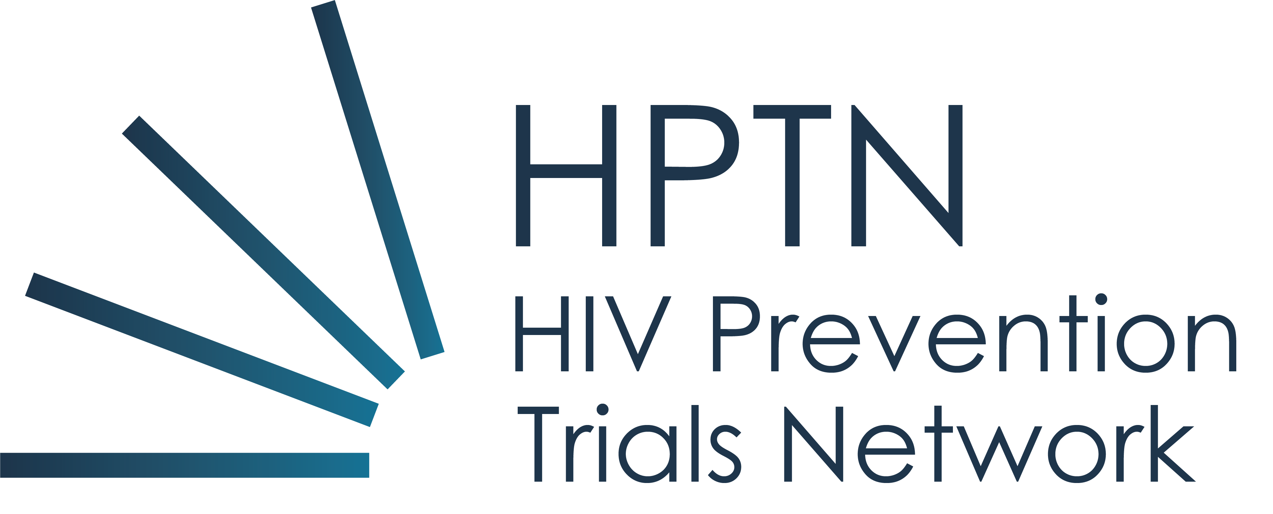
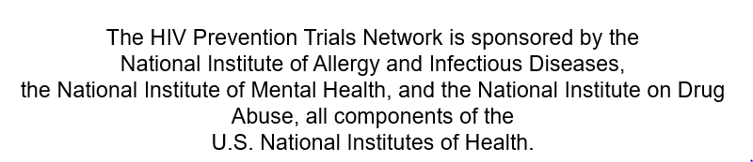
Acknowledgements
We thank study participants for trusting us with the information presented here.
We are grateful to the teams at the study sites in Johannesburg and Cape Town, South Africa, and Harare, Zimbabwe, and the HIV Prevention Trials Network that supported data collection and management for this work.
We also thank Michelle Bulterys, Miria Chitukuta, Sanele Gumede, Sybil Hosek, and Lumka Nobula for their contributions.

